Slide 1

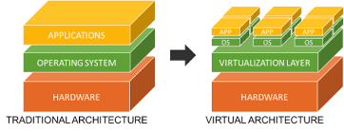
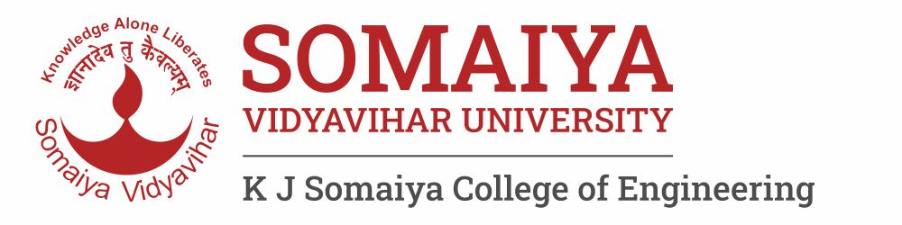

Module 2: Virtualization Technologies

Slide 2
Outline
2.1 Introduction, Characteristics of Virtualized Environments, Taxonomy of Virtualization Techniques, Virtualization and Cloud Computing, Pros and Cons of Virtualization
2.2 Technology Examples: Xen: Para virtualization, VMware: Full Virtualization, Microsoft Hyper-V
2.3 Cloud Computing Architecture : Cloud Reference Model, Types of Clouds, Economics of the Cloud, Open Challenges

Slide 3
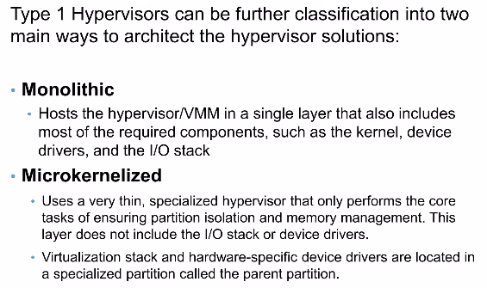
Type 1 Hypervisor Classification

Slide 4
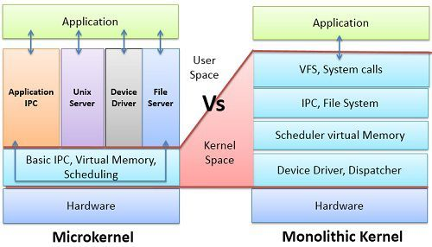
Type 1 Hypervisor Classification

Slide 5
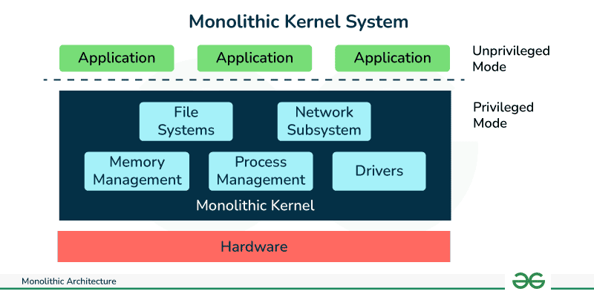
CPU scheduling
Memory management
Device drivers
I/O stack

Slide 6
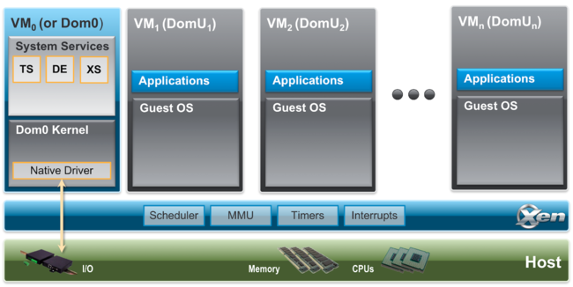
Microkernel
the hypervisor is very small and does only critical tasks:
CPU scheduling
Memory isolation
VM context switching
All drivers and I/O stacks are moved outside the hypervisor.
A special VM called the parent VM (or control domain) runs:
Device drivers
I/O stack
Management tools
Other VMs (child VMs) send I/O requests:
Child VM → Hypervisor → Parent VM → Hardware

Slide 7
Monolithic vs Microkernel
Parameter | Monolithic Hypervisor | Microkernelized Hypervisor
Hypervisor size | Large | Very small (thin hypervisor)
Device drivers location | Inside the hypervisor | In a separate parent VM
I/O stack location | Inside the hypervisor | Inside the parent VM
Virtualization stack | Part of hypervisor | Runs in parent VM
Security | Lower (large trusted code base) | Higher (smaller attack surface)
Fault isolation | Poor – driver failure may crash hypervisor | Better – driver failure isolated to parent VM
Performance | Higher I/O performance | Slight I/O overhead due to extra layer
Complexity | Simpler architecture | More complex architecture
Critical dependency | Hypervisor itself | Parent VM is critical for I/O
Typical use case | Performance-critical workloads | Security-sensitive environments

Slide 8
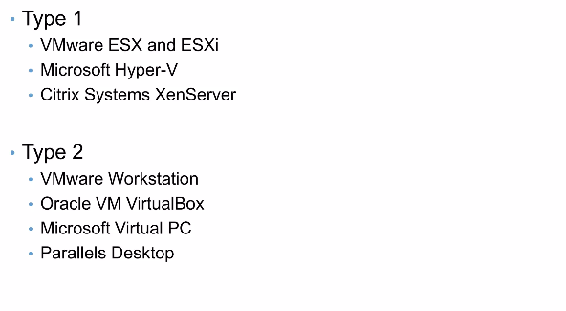
Leading Hypervisors

Slide 9
Type 1- VMware ESX and ESXi
Monolithic

Slide 10
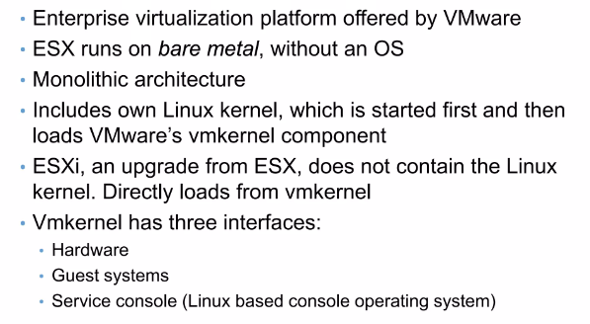
Type 1- VMware ESX and ESXi

Slide 11
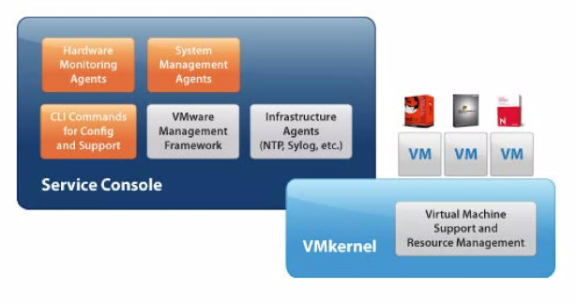
Type 1- VMware ESX Architecture
A Linux-based management environment, Used only for administration & monitoring
HARDWARE

Slide 12
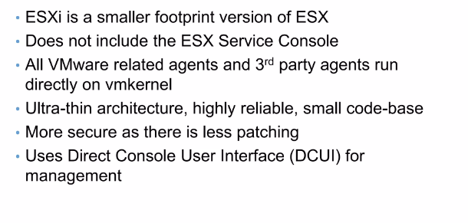
Type 1- VMware ESXi

Slide 13
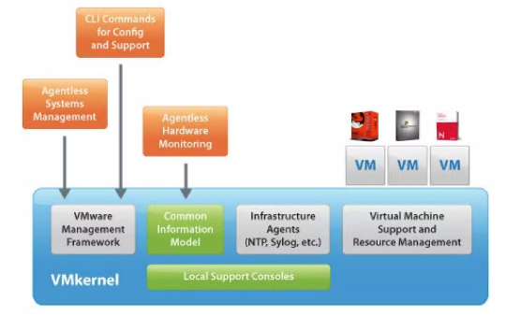
Type 1- VMware ESXi Architecture

Slide 14
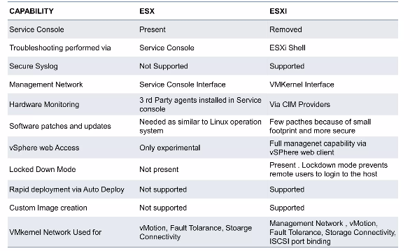
ESX and ESXi Differences

Slide 15
Type 1- Microsoft Hyper-V
Hyper-V is a Type-1, microkernelized hypervisor where only a small hypervisor runs on hardware, and all device drivers + I/O stack live in a special OS called the Root (Parent) Partition.

Slide 16
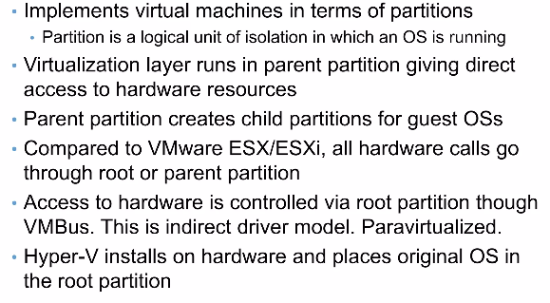
Type 1- Microsoft Hyper-V

Slide 17
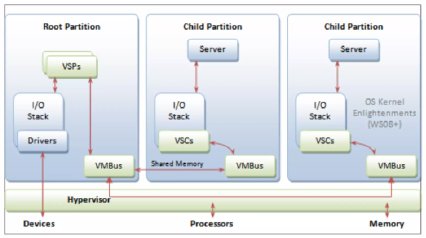
Microsoft Hyper-V Architecture
Windows OS

Slide 18
Microsoft Hyper-V Architecture
What runs inside Root Partition (from diagram)
Child Partitions (Guest VMs)
Each Child Partition contains:
Guest OS (Windows / Linux)
Applications
VSCs (Virtual Service Clients)
Component | Role
I/O Stack | Complete I/O processing
Drivers | Real hardware drivers
VSPs (Virtual Service Providers) | Provide services to child VMs
VMbus | Communication channel
Root OS Kernel | Windows kernel

Slide 19
Microsoft Hyper-V Architecture
How I/O actually works?
Let’s say a child VM wants to read a disk.
Child VM
↓
VSC (Virtual Service Client)
↓
VMbus (shared memory channel)
↓
VSP (in Root Partition)
↓
Root Partition I/O Stack
↓
Hardware Driver
↓
Physical Device

Slide 20
Type 1- Citrix Systems XenServer
Xen is a Type-1, microkernelized hypervisor that uses a special privileged virtual machine called Domain 0 (dom0) to manage hardware access and other guest VMs.

Slide 21
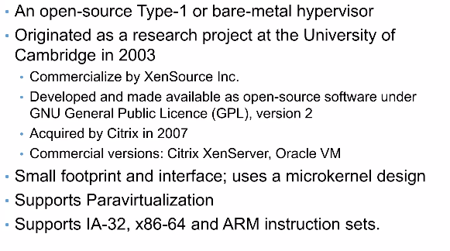
Citrix Systems XenServer

Slide 22
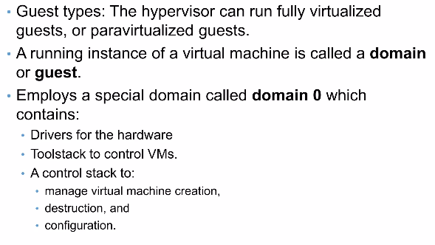
Citrix Systems XenServer Architecture

Slide 23
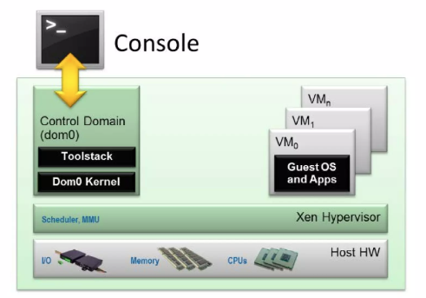
Citrix Systems XenServer Architecture

Slide 24
Citrix Systems Xen Server Architecture
What is dom0?
First VM started by Xen
Runs a special Linux OS
Has direct access to hardware
Is trusted and privileged
Guest domains (domU)
These are the normal VMs:
domU = unprivileged guest VM
Run Linux / Windows
Have applications

Slide 25
Kernel-based Virtual Machine (KVM)

Slide 26
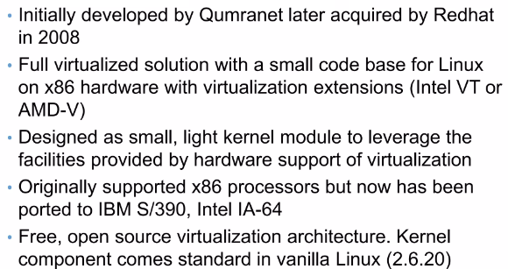
KVM

Slide 27
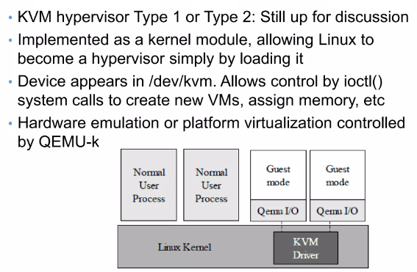
KVM

Slide 28
KVM cannot be classified as a pure Type-2 hypervisor because once KVM is loaded, Linux itself becomes the hypervisor and controls the hardware directly using hardware-assisted virtualization.
KVM is not a classical (pure) Type-1 hypervisor because it depends on a general-purpose Linux OS for device drivers, I/O stack, and management, instead of being a standalone hypervisor.

Slide 29
In Type-2 virtualization, the host OS itself already provides drivers, I/O stack, and hardware abstraction.
So the hypervisor does NOT need to:
Design a driver model
Create privileged domains
Manage hardware directly
Therefore:
No complex internal architecture is required
No standardized diagram exists

